Slide 1

“public service in the Selfie age”
Dr. Annemarie Spadafore

Slide 2
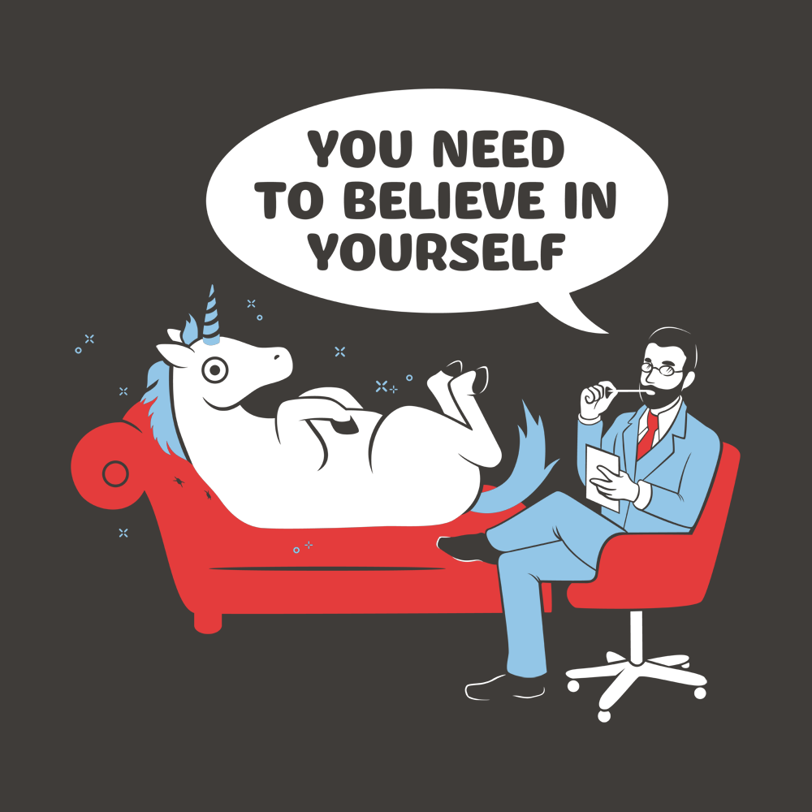
Introduction
Executive Coach and Master Facilitator
Fulbright scholar, academic, and experienced leadership development practitioner supporting hundreds of senior executive and C-Suite clients in the public and private sector
Supportive accountability partner with high enthusiasm for learning and growth

Slide 3
Today’s agenda
The Benefits of High Trust
Understanding the role of the leader in a dynamic world: How to demonstrate transformational and compelling (T&C) leadership to guide a collaborative/co-creative workforce
Value-based leadership = Success: How to bring our full selves to our leadership practice, overcoming challenges and motivating others along the way
How we encourage this behavior across our workforce

Slide 4
VUCA
Volatile. Uncertain. Complex. Ambiguous.
As leaders, how do we deal with the ‘permanent white water’ of our world today?
Notes:
Tools for a VUCA world

Slide 5
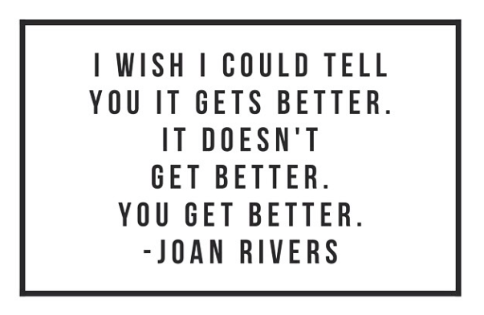

Slide 6
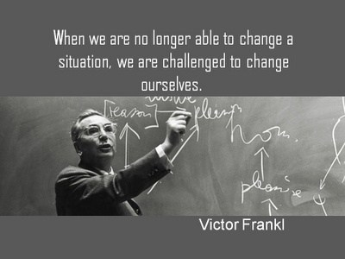
Victor Frankl: A Prescient mind on today’s challenges
The Benefits of High Trust

Slide 7
“Between stimulus and response there is a space. In that space is our power to choose our response. In our response lies our growth and our freedom”
-Dr. Victor Frankl

Slide 8
Four pillars of meaning
Belonging
Purpose
Storytelling
Transcendence

Slide 9
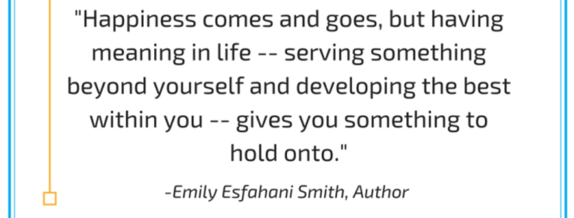
Emily Esfahani Smith: Four pillars of meaning
The Benefits of High Trust

Slide 10
How we show up as leaders matters so much!

Slide 11
In Pairs – Share your answers to BOTH questions (~4 minutes per person):
What I Am Most Proud of
What I Most Appreciate That Someone Did for Me

Slide 12
What did you notice about your stories?

Slide 13
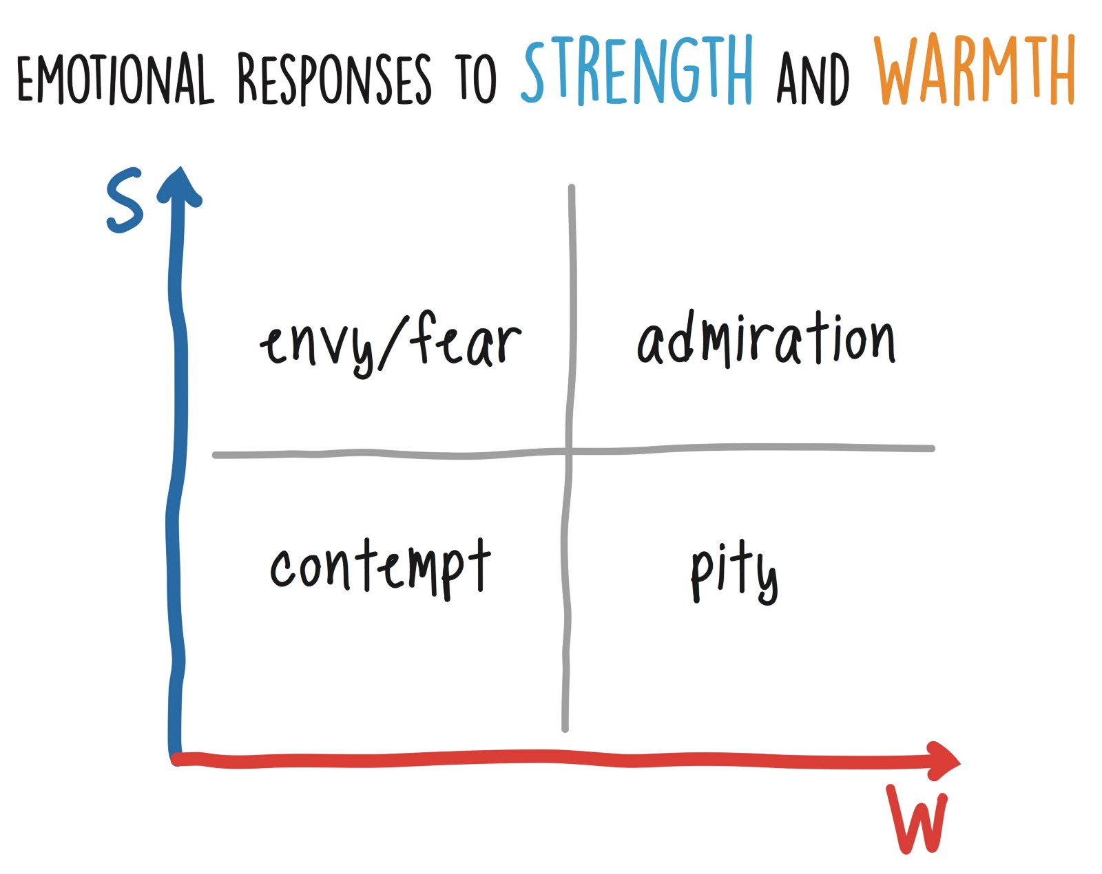
Compelling people: High Strength, High warmth
The Benefits of High Trust

Slide 14
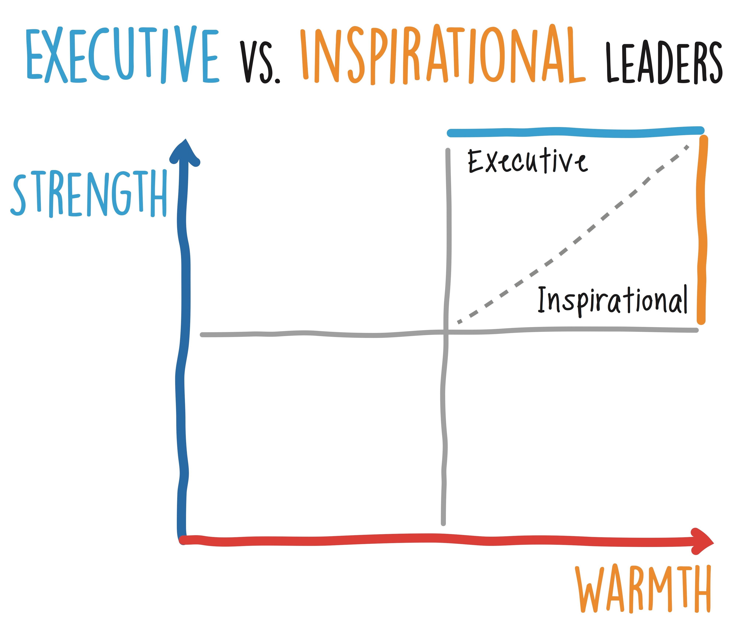
Two types of high strength, high warmth
The Benefits of High Trust

Slide 15
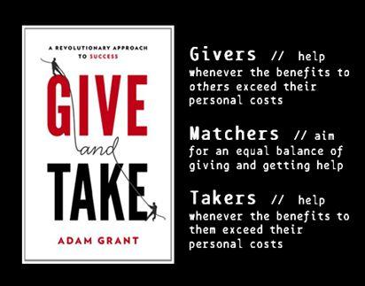
Adam Grant: Givers – Matchers - takers
The Benefits of High Trust

Slide 16
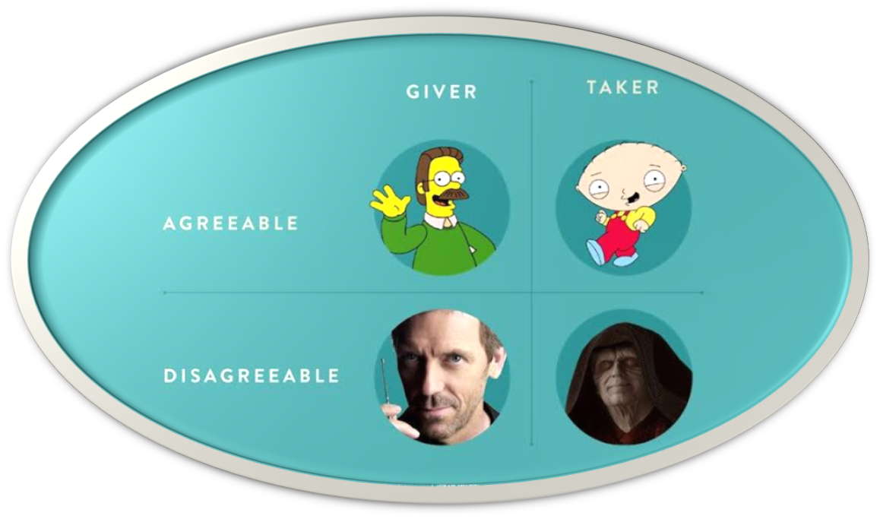
Types of Givers and Takers
The Benefits of High Trust

Slide 17
The Outward Mindset: An approach to work that motivates ‘pro-social’ work behaviors

Slide 18
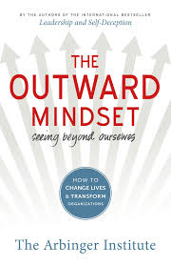
Arbinger institute: The outward Mindset
The Benefits of High Trust

Slide 19
Inward vs. outward mindset
The Benefits of High Trust
Inward Mindset:
Protect and advance our own agendas; our objectives and behaviors are SELF-FOCUSED
See others as OBJECTS:
  Those that can help us are VEHICLES
  Those that make things more difficult are OBSTACLES
  Those whose help wouldn’t matter are IRRELEVANT
Outward Mindset:
Focus on advancing the COLLECTIVE result
See others as PEOPLE:
  Our objectives and behaviors take others’ wellbeing into account
  We are alive to and interested in others’ needs, objectives, and challenges

Slide 20
Inward vs. outward mindset In action
The Benefits of High Trust
Inward Mindset: Seeing Others as OBJECTS
Focus: Benefiting SELF
Approach: Self is MORE IMPORTANT than others
Behaviors: Limits others, seeks spotlight
Beliefs: Others are NOT doing their best
Outward Mindset: Seeing Others as PEOPLE and VALUING them as such
Focus: Benefitting team
Approach: Others are valuable partners
Behaviors: Shares spotlight, includes others
Beliefs: Others are doing their best

Slide 21
Inward vs. outward mindset Outcomes
The Benefits of High Trust
Inward Mindset
My Organization/Group
My Interests
Siloes
Tunnel Vision
Behaviors that Protect and Advance ME and MY GROUP
Outward Mindset
The Bigger System
Our Shared Purpose
Collaboration
Awareness
Behaviors that Advance the COLLECTIVE RESULT

Slide 22
SAM Model for Developing a more Outward Organization
See Others
Adjust Efforts
Measure Impact

Slide 23
In Pairs – Share your answers to the following question (~3 minutes per person):
What is one way I may see others and adjust my efforts to demonstrate leadership that aligns with my values?

Slide 24
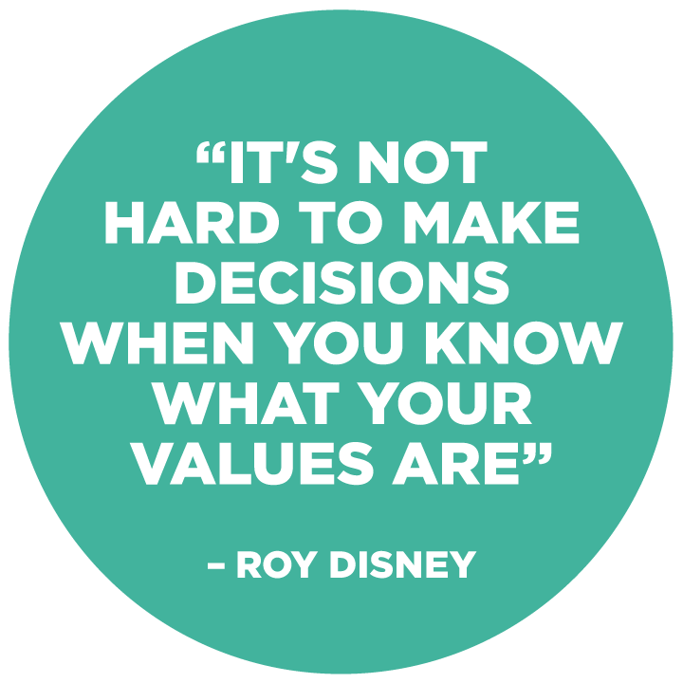

Slide 25
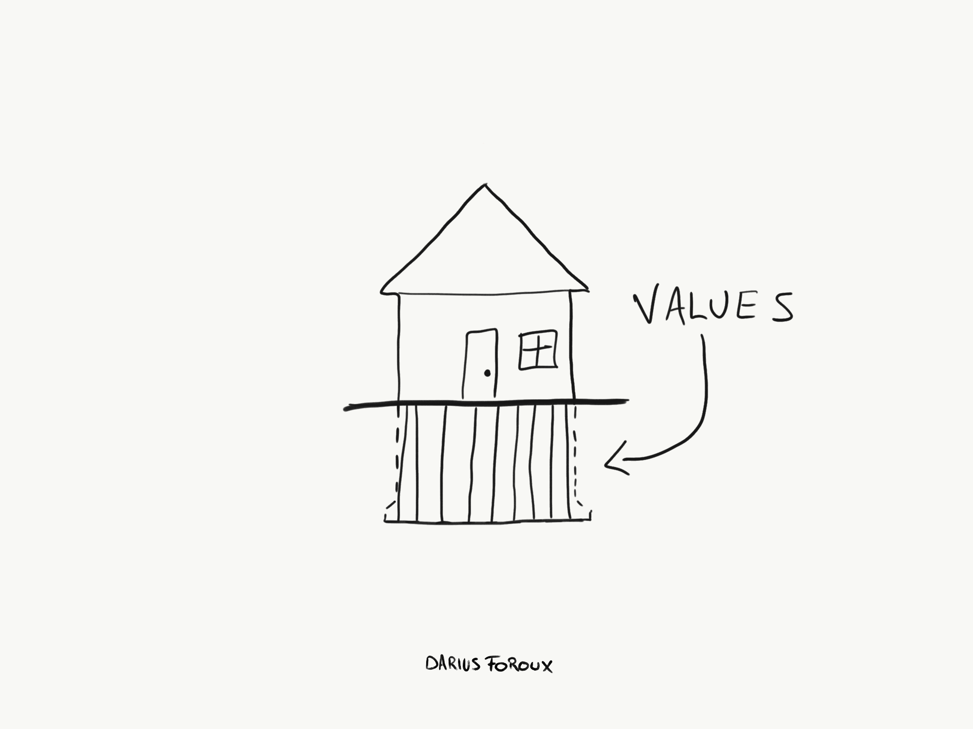
Get to know your values
What are your core values?
What are the values of others?
How can understanding your values and those of others help you lead with meaning?

Slide 26
Close-out
The Benefits of High Trust
A VUCA world needs dedicated leaders committed to their own professional growth
Transformative and Compelling (T&C) leaders create meaning for themselves and those they lead to overcome challenges
T&C leaders demonstrate BOTH high credibility (strength) and high emotional connection (warmth)
T&C leaders model and encourage pro-social behaviors in the workplace
T&C leaders utilize an ‘outward’ mindset and lead from their values; they foster an environment that encourages others to do the same

Slide 27
Stay in touch!
Dr. Annemarie M. Spadafore
Spark!
Info@coachmespark.com
www.coachmespark.com
703-996-9310

